Slide 1

Data Structures in Python

Slide 2

Agenda
Introduction to Greedy techniques
Activity selection and greedy examples
DP on Trees concept
DP with Bitmasking
DP with Segments
Practice examples and applications

Slide 3
Unit Overview
This unit introduces the Greedy approach and advanced Dynamic Programming techniques used to solve optimization problems efficiently. Students will learn how greedy algorithms make optimal choices step by step and how advanced DP techniques solve complex problems involving trees, subsets, and segments.
These concepts are useful in real-world applications like scheduling, route optimization, and decision-making systems.

Slide 4
What is Greedy Algorithm?
A Greedy algorithm makes the best choice at each step hoping it leads to a global optimal solution.
It does not reconsider past choices.
When to Use Greedy?
Greedy works when:
Problem has Greedy Choice Property
Problem has Optimal Substructure

Slide 5
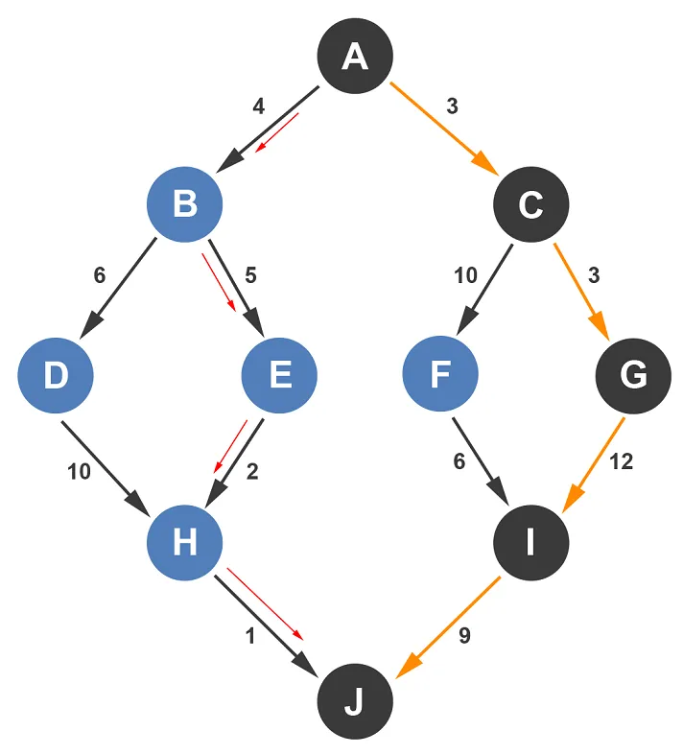
What is Greedy Algorithm?

Slide 6
Activity Selection Problem
Sellect maximum number of non-overlapping activities.
Activities:
Start: 1 3 0 5 8 5
End: 2 4 6 7 9 9
Greedy Strategy
Step 1: Sort by finish time Step 2: Always pick activity that finishes first
Selected activities:
(1,2), (3,4), (5,7), (8,9)

Slide 7
Coin Change (Greedy)
Coins: 1, 5, 10, 25 Amount = 30
Greedy approach:
25 + 5 = 30
Minimum coins = 2
Note: Greedy does NOT always work for all coin systems.

Slide 8
DP on Trees
Dynamic Programming applied on tree structures.
Used when:
Problem involves subtree values
Parent-child dependency exists

Slide 9
Maximum Sum of Non-Adjacent Nodes
Tree:
10
/ \
1 2
/ \
3 4
Rule: Cannot select parent and child together.
Logic
For each node:
Include node value + grandchildren Exclude node → take children

Slide 10
DP with Bitmasking
Bitmasking represents subsets using binary numbers.
Example:
For 3 elements:
000 → empty
001 → {A}
010 → {B}
011 → {A,B}
When to Use?
Small N (≤ 20)
Subset problems
Traveling Salesman Problem (TSP)

Slide 11
Traveling Salesman Problem (DP + Bitmask)
Idea:
dp[mask][i] = minimum cost to reach node i using visited set mask.
Time Complexity:
O(n² × 2^n)
Used in:
Route planning
Optimization problems

Slide 12
DP with Segments
Used when:
Problem can be divided into continuous ranges
Involves intervals or segments
Example problems:
Matrix chain multiplication
Partitioning array
Interval scheduling

Slide 13
Maximum Subarray (Kadane’s Algorithm)
Python Example
def max_subarray(arr):
current = arr[0]
maximum = arr[0]
for i in range(1,len(arr)):
current = max(arr[i], current + arr[i])
maximum = max(maximum, current)
return maximum
arr = [-2,1,-3,4,-1,2,1,-5,4]
print(max_subarray(arr))
Given:
[-2,1,-3,4,-1,2,1,-5,4]
Find maximum sum of contiguous segment.

Slide 14
Real-World Applications
Greedy:
Scheduling
Network routing
Resource allocation
Advanced DP:
Game strategy optimization
Robotics
AI decision systems
Financial optimization

Slide 15
Why Dynamic Programming?
Some problems repeat the same calculations many times.
Example: Fibonacci
Normal recursion:
F(5)
├── F(4)
│ ├── F(3)
│ │ ├── F(2)
│ │ └── F(1)
│ └── F(2)
└── F(3)
├── F(2)
└── F(1)
Here F(3) and F(2) are calculated multiple times.
DP solves this problem by storing results.

Slide 16
Key Concepts of DP
Two important properties:
1. Overlapping Subproblems
Same problem solved multiple times.
Example:
F(3) calculated again and again.
2. Optimal Substructure
Optimal solution can be built from optimal subproblems.
Example:
F(n) = F(n−1) + F(n−2)

Slide 17
Key Concepts of DP
Fibonacci Problem Example
Fibonacci sequence:
0, 1, 1, 2, 3, 5, 8, 13
Formula:
F(n) = F(n−1) + F(n−2)

Slide 18
Key Concepts of DP
Recursive Solution (Without DP)
Python example:
def fibonacci(n):
if n <= 1:
return n
return fibonacci(n-1) + fibonacci(n-2)
print(fibonacci(5))
Output:
5
Problem with Recursion
Time Complexity:
O(2^n)
Very slow for large n.

Slide 19
Memoization (Top-Down Approach)
Memoization stores results of function calls and reuses them when needed.
Avoids repeated calculations.
How Memoization Works
Step 1: Check if result already exists Step 2: If yes → return result Step 3: If no → calculate and store

Slide 20
Memoization (Top-Down Approach)
Memoization Visualization
memo = {
0:0,
1:1,
2:1,
3:2,
4:3,
5:5,
6:8
}
Stored values reused.
Time Complexity
O(n)
Much faster than recursion.

Slide 21
Tabulation (Bottom-Up Approach)
Tabulation solves problem from bottom and stores results in table.
Starts from smallest value.
How Tabulation Works
Step 1: Create table Step 2: Fill values from beginning Step 3: Use stored values
Table Visualization
Index: 0 1 2 3 4 5 6
Value: 0 1 1 2 3 5 8
Time Complexity
O(n)

Slide 22
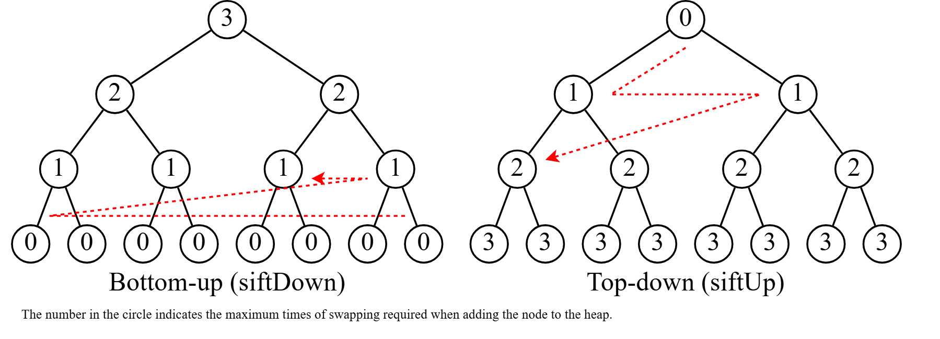

Slide 23
Real-World Applications
Dynamic Programming used in:
Shortest path algorithms
Google Maps
Resource optimization
Game development
Robot navigation

Slide 24
Example Problem
You can climb 1 or 2 steps.
Find number of ways to reach step n.
Example:
n = 4
Ways:
1+1+1+1
1+1+2
1+2+1
2+1+1
2+2
Answer = 5

Slide 25
Key Outcomes
Understand Greedy algorithm approach
Apply Greedy techniques to solve problems
Understand DP on Trees
Implement DP using Bitmasking
Solve problems using DP with Segments
Apply advanced optimization techniques

Slide 26
Thank You!

